Slide 1
Project C.A.S.P.
Week 8

Slide 2
Overview
Linked up all submodules to the Core module
Progressed in implementation of Outline Module
Came up with sample inputs for Outline and Analyze
Expectations for each, Checkpoints for completion

Slide 3
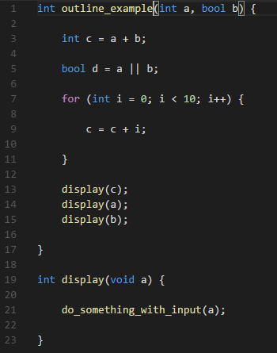
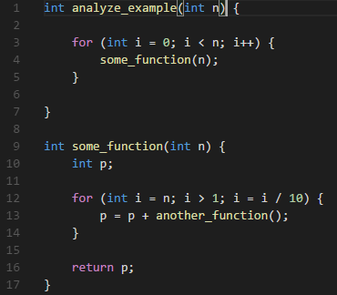
Examples
Outline (left)
Recognize the following artifacts:
Addition of a & b
Logical OR of a & b
For loop from 0 to 10
Addition of c & I
Method call of display (x3)
Another method call within display
Analyze (right)
Recognizes For loop from 0 to n
Finds O(n)
Recognizes method call & analyzes
Finds “int p” to be constant (ignores in this case)
Recognizes For loop from n to 1, division by 10
Finds O(log n)
Finds “return p” to be constant (ignores)

Slide 4
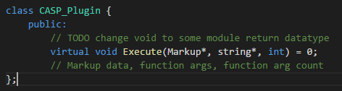
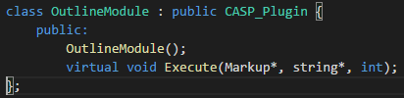
CASP Plugin
Each plugin will inherit the abstract CASP_Plugin class
Requires method Execute()
Connection between Control Module and Plugin Module
Accepts the code markup object and any additional command line plugin arguments
We were looking into dynamic plugin injection, but compiling the entire program with plugins included is the easiest right now
External program dedicated to the plugins or some method of “installing” the plugin
Modular enough to easily update if necessary

Slide 5
Weekly tasks
Ryan – Complete (hopefully) Outline module
If completed, begin implementation of Standalone Windows Application
Dylan – Complete (possibly) Analyze module
If completed, begin implementation of Lint Module
Chris – Continue Implementation of Translate module

